Slide 1
Introduction to C++
Modular program: A program consisting of interrelated segments (or modules) arranged in a logical and understandable form
Easy to develop, correct, and modify
Modules in C++ can be classes or functions

Slide 2
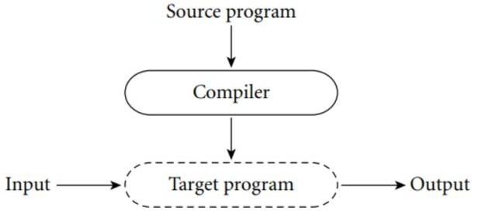
Compilation Process in C++

Slide 3
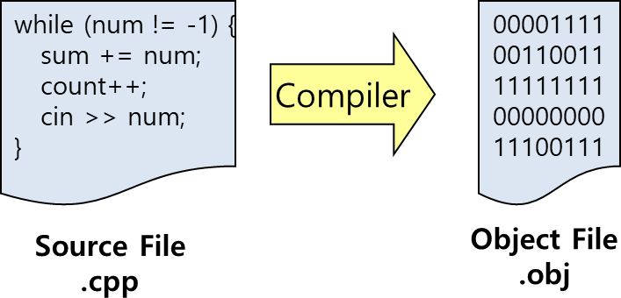
Compilation Process in C++
Compiler : Translates high-level language to machine language.
  Input to a compiler is the source code
  Output from the compiler is the object code (.obj).
Notes:
https://www.msys2.org/

Slide 4
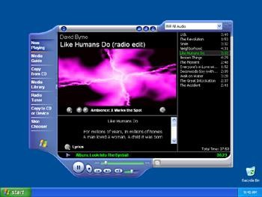

Compilation Process in C++
Linker : Combines your object code with pre-compiled object libraries for input/output etc.
Input are the object files (.obj).
Output is the executable file (.exe) in Windows.
00001111
00110011
11111111
00000000
11100111
00001111
00110011
11111111
00000000
11100111
Linker
Object File
.obj
Executable File
.exe
Library Files
.obj

Slide 5
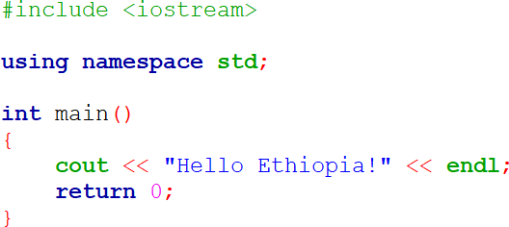
Basic structure of a C++ program

Slide 6
Basic structure of a C++ program
Line - 1
Line - 2
Line - 3
Line - 4
Line - 5
Line - 6
Line - 7
Line - 8
Line - 9

Slide 7
Basic structure of a C++ program
Line – 1 : Preprocessor directive/command
Starts with a #
give instructions to the compiler to preprocess the information before actual compilation starts
#include <file name>
  Causes the named file to be inserted into the source code
C++ provides a standard library
  with many pre-written classes that can be included
Header files
  Files included at the head (top) of a C++ program

Slide 8
Basic structure of a C++ program
Line – 3 : Namespace
provide the space where we can define or declare identifier i.e. variable, method, classes.
Using namespace, you can define the space or context in which identifiers are defined i.e. variable, method, classes.
In essence, a namespace defines a scope.
Advantage of Namespace is to avoid name collision.
All identifiers at namespace scope are visible to one another without qualification.
Identifiers outside the namespace can access the members by using the fully qualified name for each identifier std:: cout<<

Slide 9
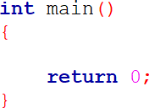
Basic structure of a C++ program
Line – (5-9) : Main function
main() function is the entry point of any C++ program.
It is the point at which execution of program is started.
When a C++ program is executed, the execution control goes directly to the main() function.
Every C++ program have a main() function.
All other functions are invoked from main()

Slide 10
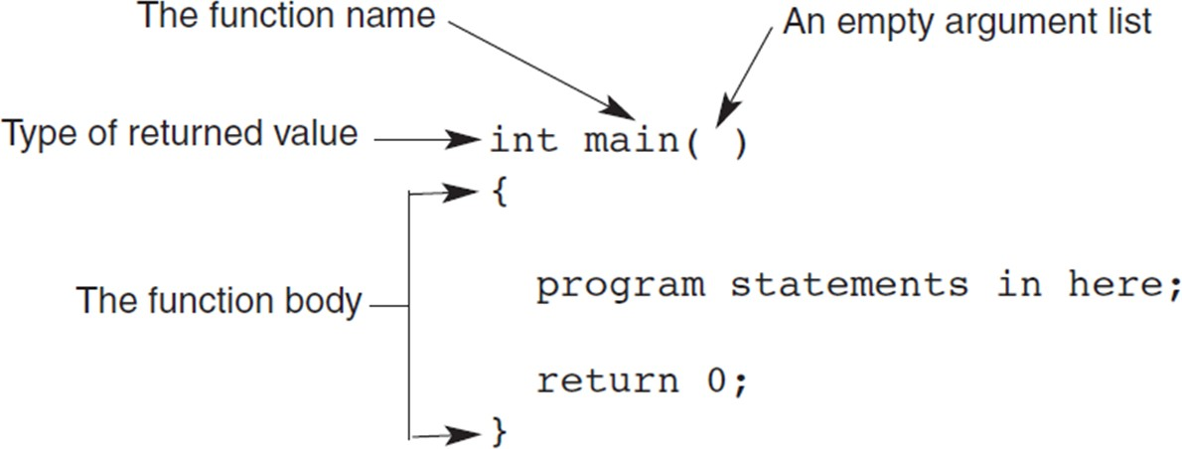
Basic structure of a C++ program

Slide 11
Basic structure of a C++ program
Line – (5-9) : Main function
Function header line: First line of a function, which contains:
  The type of data returned by the function (if any)
  The name of the function
  The type of data that must be passed into the function when it is invoked (if any)
Arguments: The data passed into a function
Function body: The statements inside a function
enclosed in braces (opening “{“ and closing “}”)

Slide 12
Basic structure of a C++ program
Line – (5-9) : Main function
Each statement inside the function must be terminated with a semicolon ;
return: A keyword causing the appropriate value to be returned from the function
The statement return 0 in the main() function causes the program to end

Slide 13

cout object
It is used to display the output to the standard output device i.e. monitor.
It is defined in iostream header file.
It is associated with the standard C output stream stdout.
The data needed to be displayed on the screen is inserted in the standard output stream (cout) using the insertion operator(<<).

Slide 14
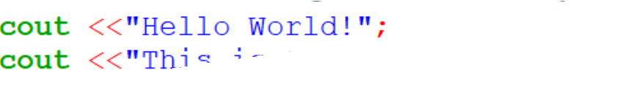



endl object
The endl is a predefined object of ostream class.
It is used to insert a new line characters and flushes the stream.

Slide 15

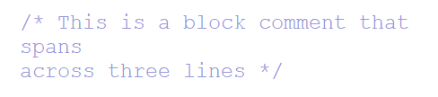
Comments
Comments can be used to explain C++ code, and to make it more readable.
Comments can be singled-lined or multi-lined/block.
Single –line comment :
Begins with // and continues to the end of the line
Example :
multi –line/block comment :
comments that span across two or more lines
Begin with /* and end with */
Example :

Slide 16
Variables
Variable : is a name given to a memory location.
It is the basic unit of storage in a program.
  The value stored in a variable can be changed during program execution.
  all the operations done on the variable effects that memory location.
  Each memory location has a unique address
  In C++, all the variables must be declared before use.

Slide 17
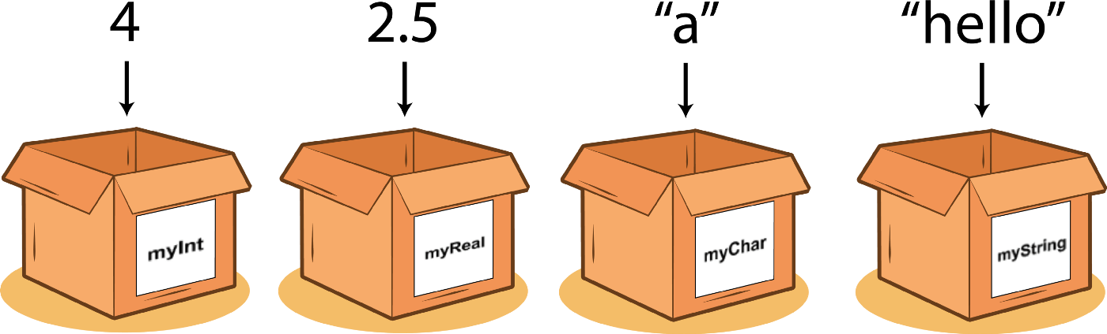
Variables
Cardboard Label (myInt, myReal) | → → | memory locations variable
4,2.5,”a”,”hello” | → | values

Slide 18
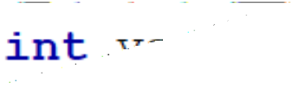
Variables
Variable declaration :
Syntax:
( without initialization)
dataType variableName;
( with initialization)
dataType
variableName=value;

Slide 19

Data Types
A data type : specifies the type of data that a variable can store such as integer, floating, character etc.
Specifies set of values and the operations that can be applied to these values

Slide 20
Data Types
Types | Data types
Basic/primitive data types | int, char, float, double, etc
Derived data types | array, pointer, etc
Enumeration Data Type | enum
User Defined Data Type | Structure, class

Slide 21
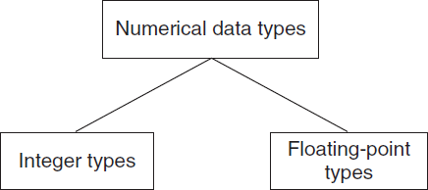
Primitive data types

Slide 22
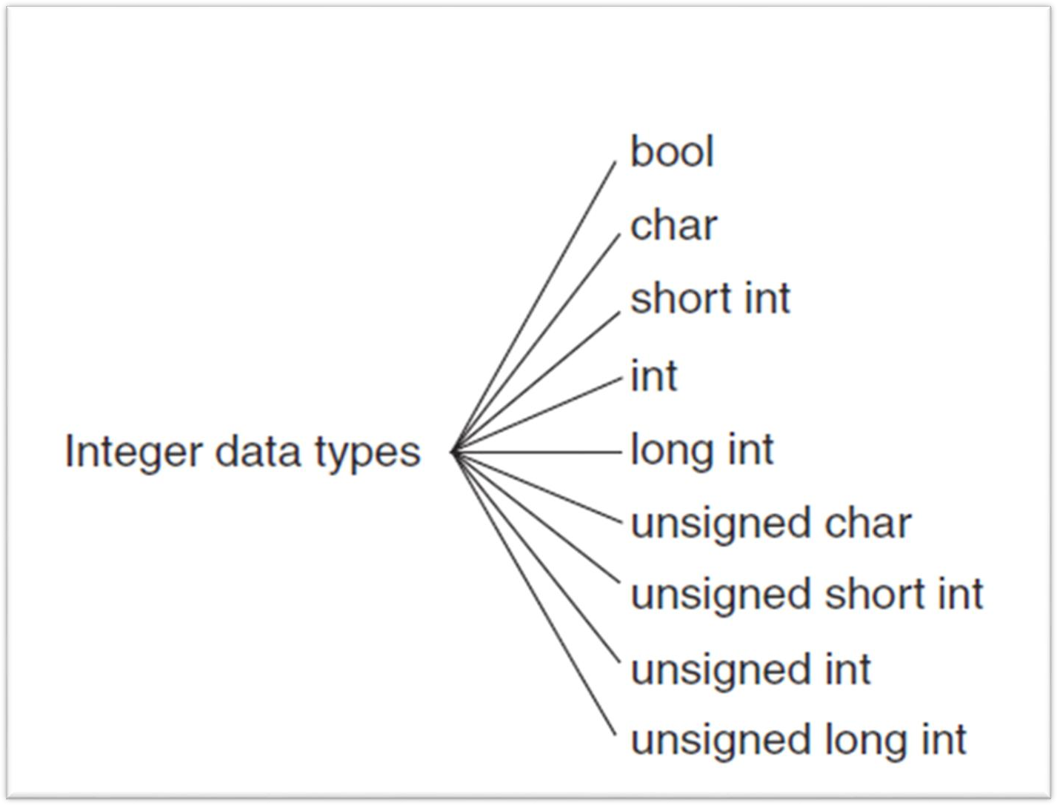
Primitive data types
C++ has nine built-in integer data types Each provides different amounts of storage (compiler dependent)

Slide 23
Primitive data types
int data type: Whole numbers (integers), optionally with plus (+) or minus (–) sign
  Example: 2, -5
char data type: Individual character; any letter, digit, or special character enclosed in single quotes
  Example: ‘A’
  Character values are usually stored in ASCII code

Slide 24
Primitive data types
bool data type: Represents Boolean (logical) data
  Restricted to two values: true or false
  The default numeric value of true is 1 and false is 0.
  We can use bool type variables or values true and false in mathematical expressions also.
  Example :int x = false + true +6
  It is also possible to convert implicitly the data type integers or floating point values to bool type.

Slide 25
Signed and Unsigned Data Types
Signed data type: One that permits negative, positive, and zero values
Unsigned data type: Permits only positive and zero values
  An unsigned data type provides essentially double the range of its signed counterpart

Slide 26
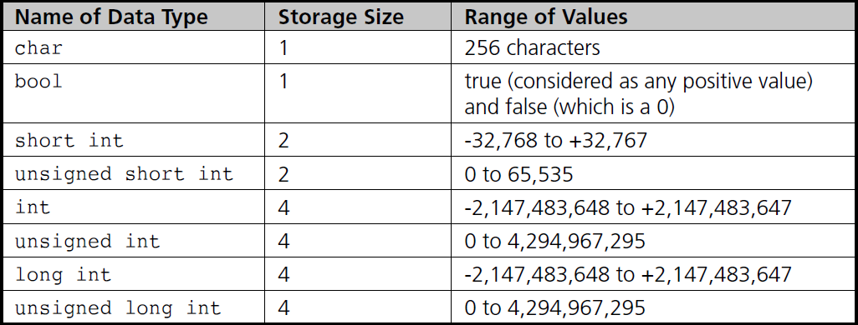
Integer Data Types

Slide 27
Floating-Point Types
(real number): Zero or any positive or negative number containing a decimal point
  Examples: +10.625 5. -6.2
  No special characters are allowed
  Three floating-point data types in C++:
    float (single precision)
    double (double precision)
    long double

Slide 28
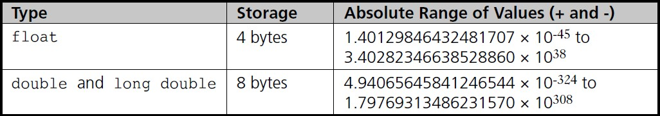
Floating-Point Types

Slide 29
Variable name
Any naming in c++ program including variable name should follow valid identifier naming rules.
Identifier :
  Identifier refers to name given to entities such as variables, functions, arrays, classes, constants, structures, pointers etc.
  Identifiers must be unique.
  They are created to give a unique name to an entity to identify it during the execution of the program.

Slide 30
Valid identifier naming rules
Names can contain letters, digits and underscores
Names must begin with a letter or an underscore (_)
Names are case sensitive (myVar and myvar are different variables)
Names cannot contain whitespaces or special characters like !, #,
%, etc.
Key words/Reserved words (like C++ keywords, such as int) cannot be used as names
Maximum length of an identifier =1024 characters

Slide 31
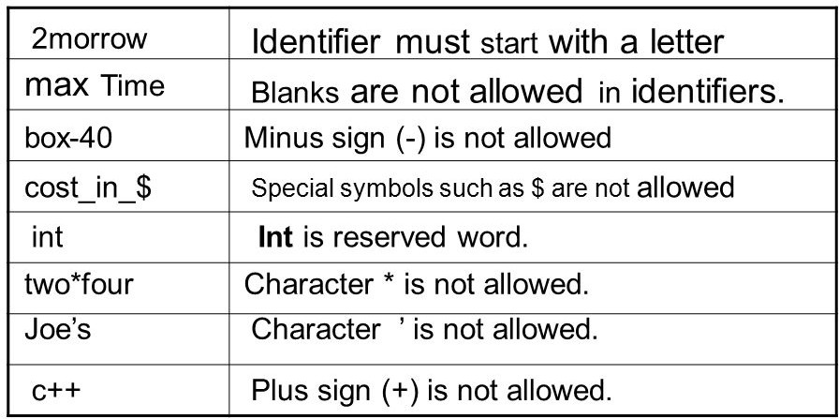
Valid identifier naming rules
Examples of valid C++ identifiers:
degToRad intersect addNums slope multTwo findMax density
bessell

Slide 32
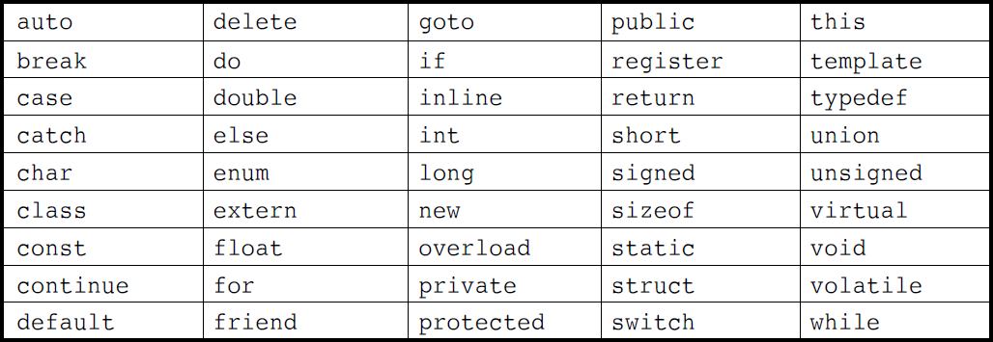
Key / Reserved words
Keywords (also known as reserved words)
have special meaning to the C++ compiler.
always written or typed in short(lower) cases.
Keywords are words that the language uses for a special purpose

Slide 33
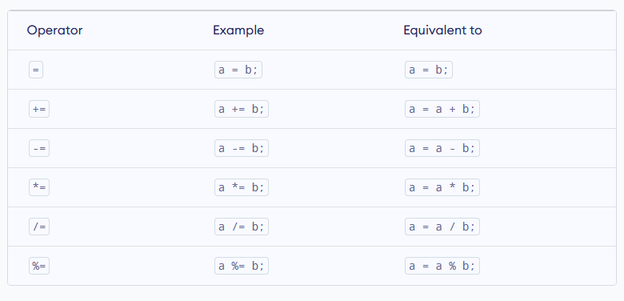
Assignment Operators

Slide 34
Increment and Decrement Operators
C++ also provides increment and decrement operators: ++ and -- respectively.
▪ ++ increases the value of the operand by 1
-- decreases it by 1

Slide 35
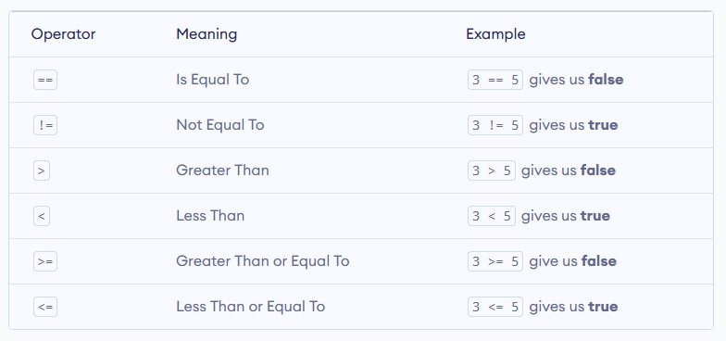
Relational Operators

Slide 36
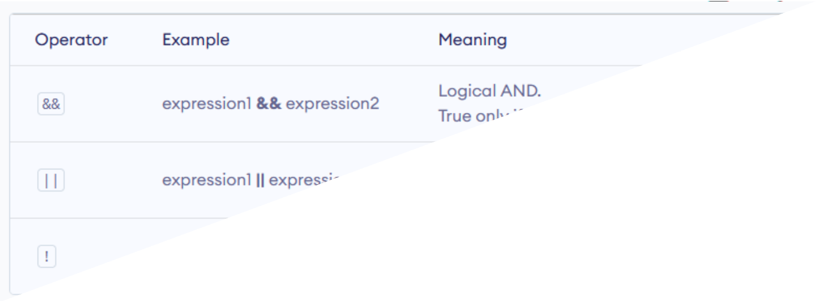
Logical Operators

Slide 37
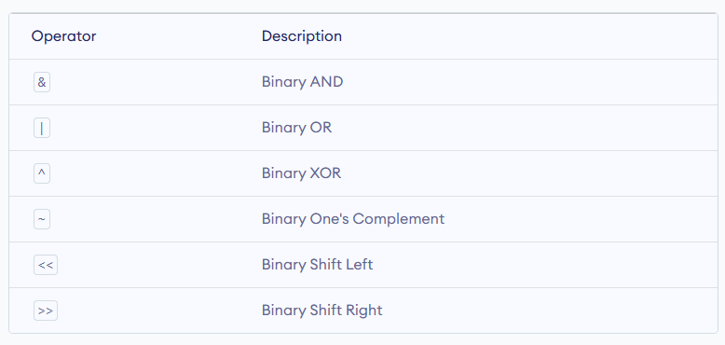
Bitwise Operators

Slide 38
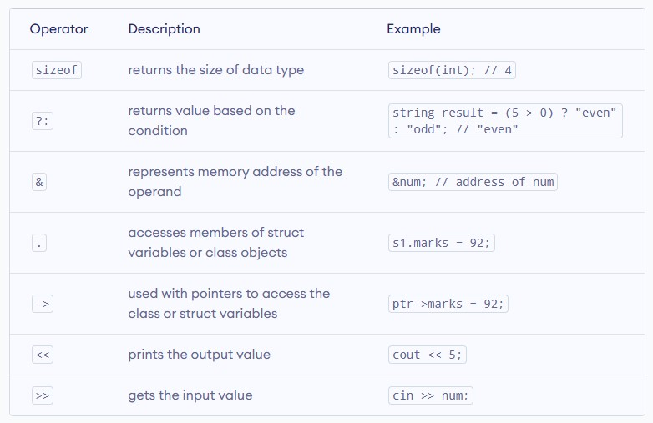
Other C++ Operators

Slide 39
C++ Operator Precedence and Associativity
If there are multiple operators in a single expression, the operations are not evaluated simultaneously. Rather, operators with higher precedence have their operations evaluated first.
Let us consider an example: int x = 5 - 17 * 6;
Here, the multiplication operator * is of higher level precedence than the subtraction operator -. Hence, 17 * 6 is evaluated first.
As a result, the above expression is equivalent to int x = 5 - (17 * 6);

Slide 40
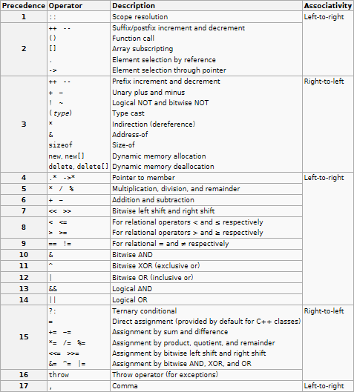

Slide 41
END
Of
Lecture -2

